Slide 1
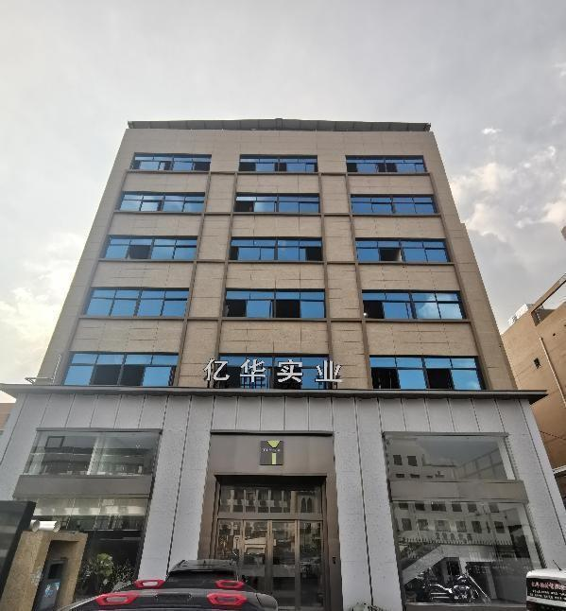
Wenzhou Yihua Industry Co., Ltd. Ruian MY Import&Export Co., Ltd.
 | FACTORY INTRODUCTION
Wenzhou Yihua Industry Co.，Ltd. is established in 2001. We are located in the professional rubber shoes area Ruian city. Now we have 400 emplyees. We are strong at vulcanized shoes and injection shoes. We also produce and sale raw material.
We have separate sales and production buldings. With advanced equipment, excellent quality, top R&D, good sales system and perfect service, we always earn great reputation from customers.

Slide 2
01 About US
02 Sample Room
03 Workshop
04 Testing
05 What we can do
06 Partners
07 Products
08 Show Room

Slide 3
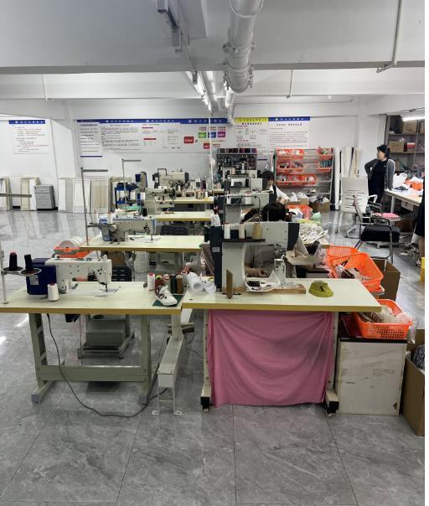
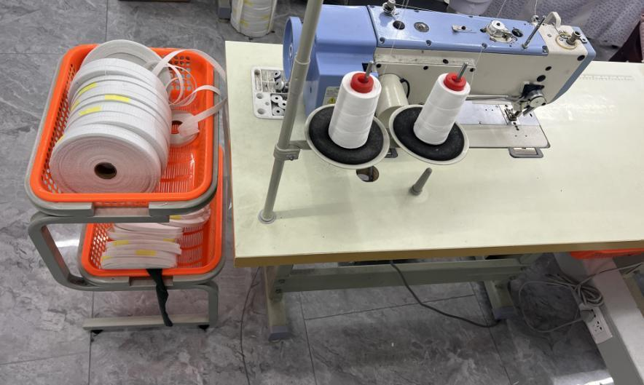
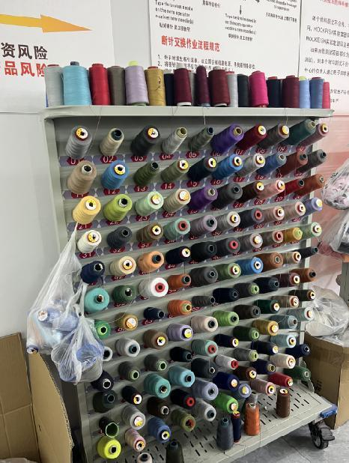
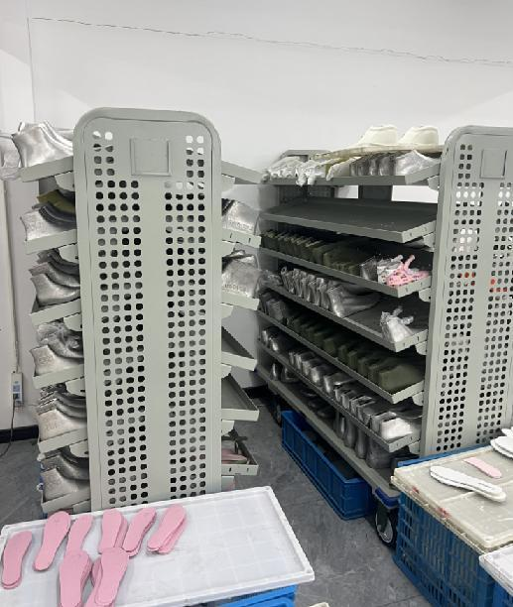
PRODUCTION PROCESS OF SHOES
PART 1
PRODUCT
Our Sample Room R&D Center
How Is Shoes Been Made?

Slide 4
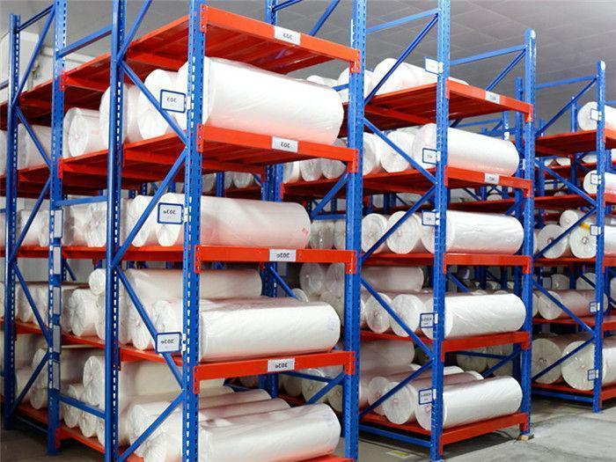
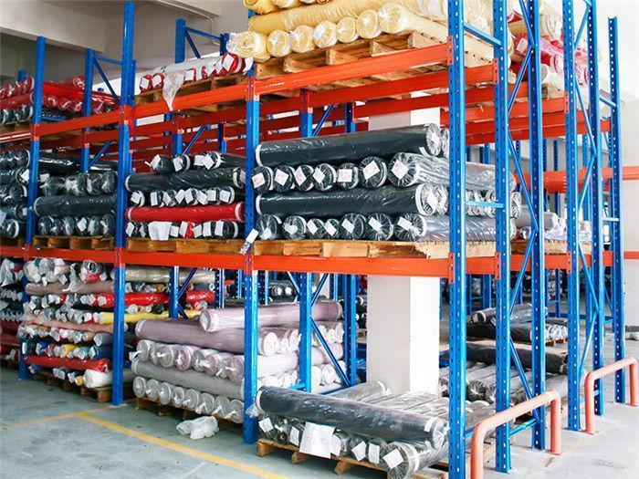
PRODUCTION PROCESS OF SHOES
PART 2
PRODUCT
Meterial Warehouse
.

Slide 5
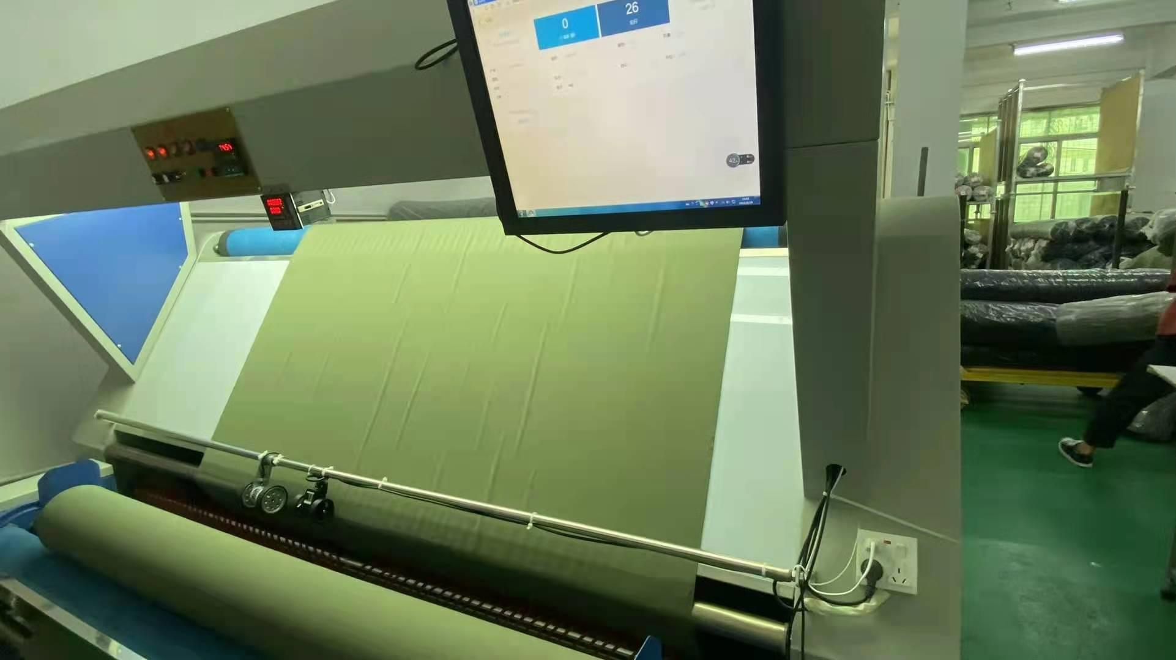
PRODUCTION PROCESS OF SHOES
PART 3
PRODUCT
Fabric Inspection

Slide 6
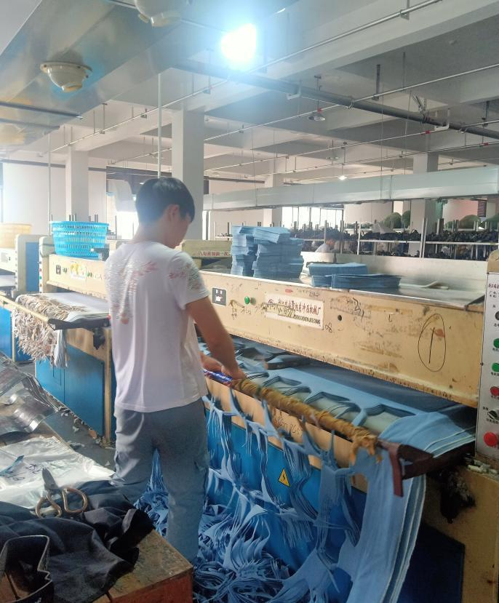
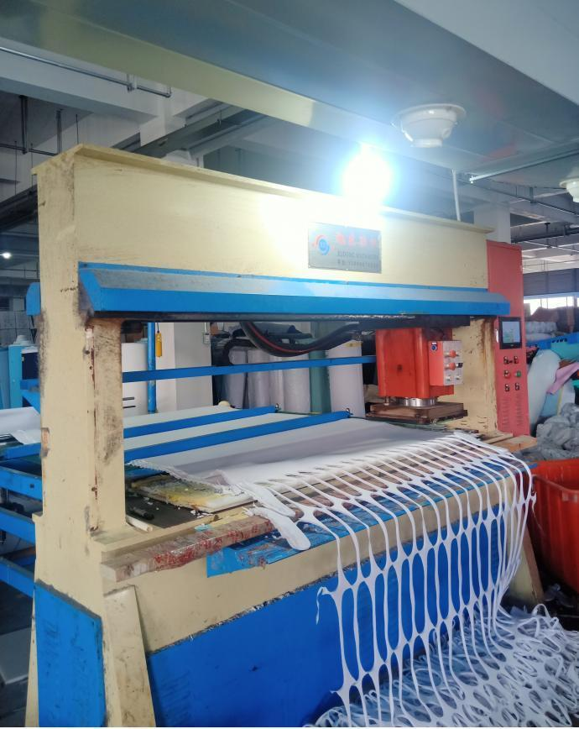
PART 4
PRODUCTION PROCESS OF SHOESG
PRODUCT
Cutting Department

Slide 7
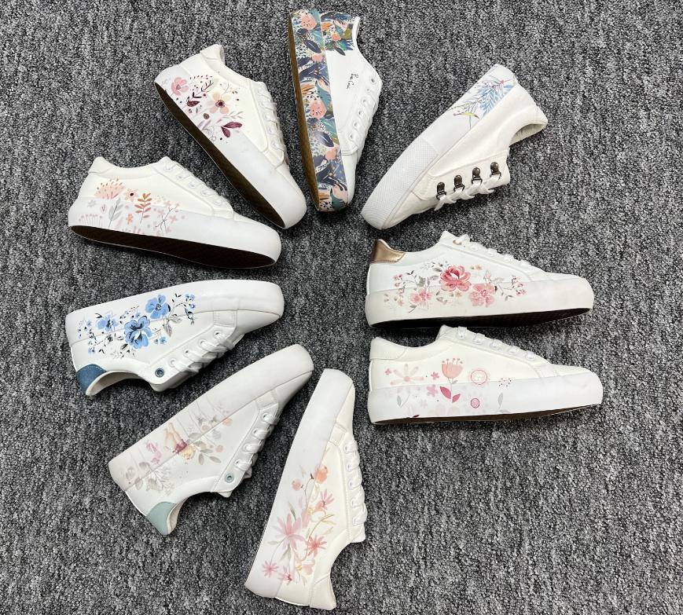
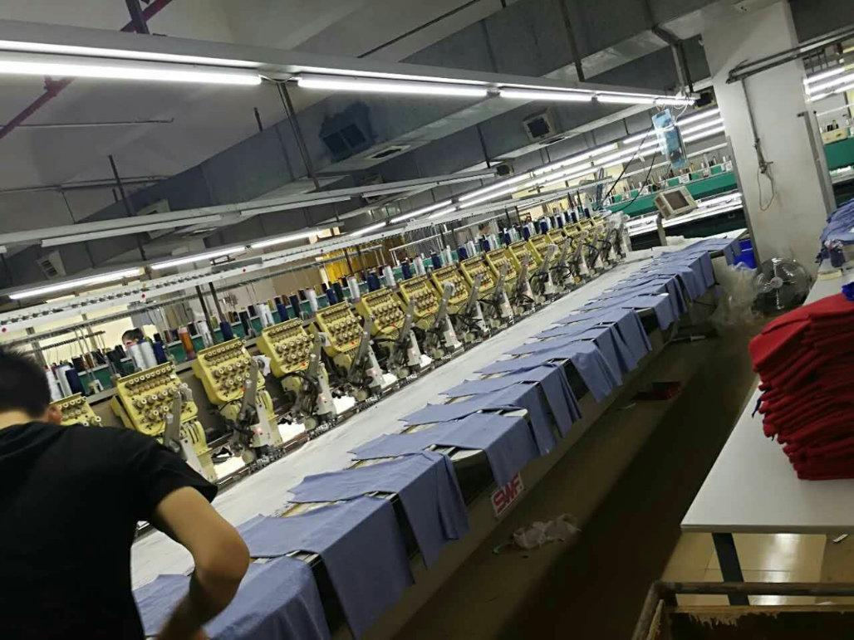
PRODUCTION PROCESS OF SHOES
PART 5
PRODUCT
3D Printing
Embroidery

Slide 8
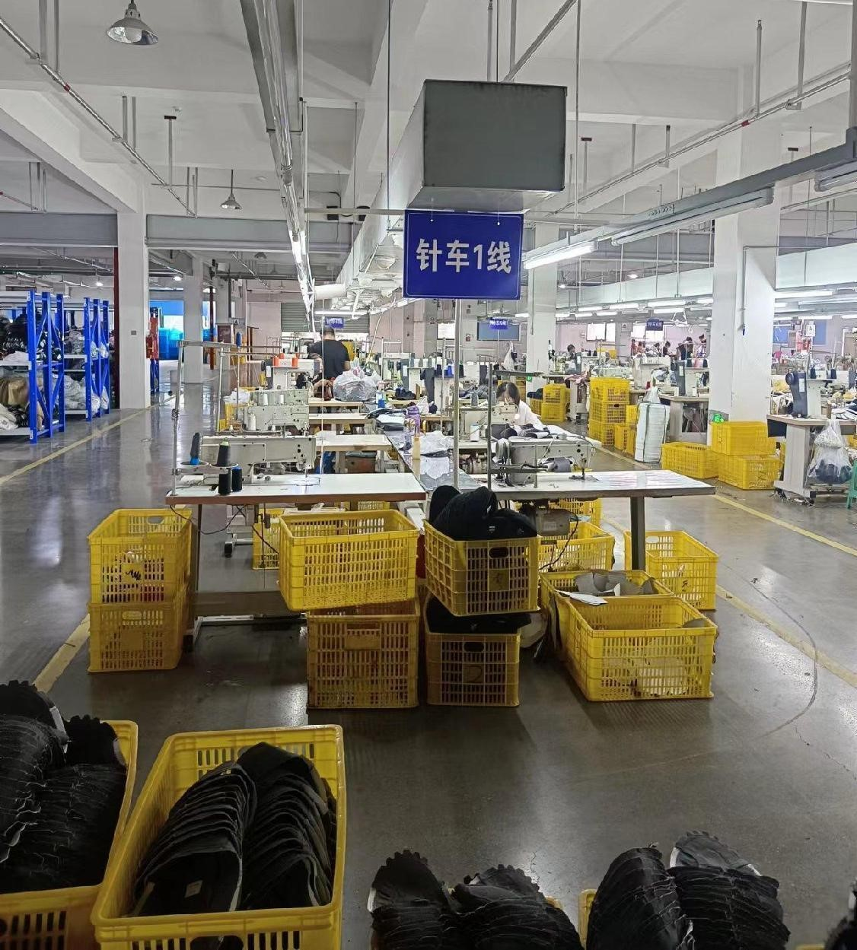
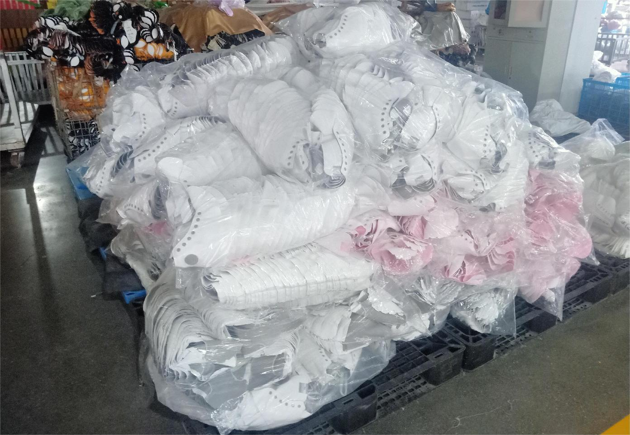
PRODUCTION PROCESS OF SHOES
PART 6
Sewing Department
completed upper

Slide 9
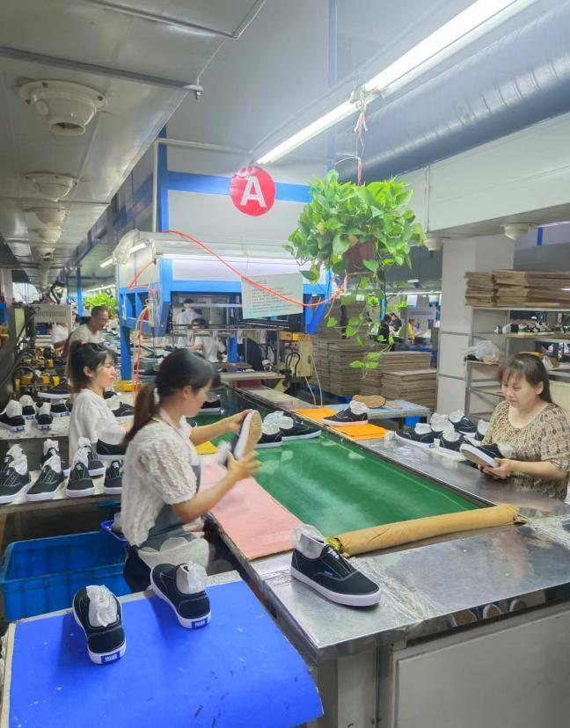
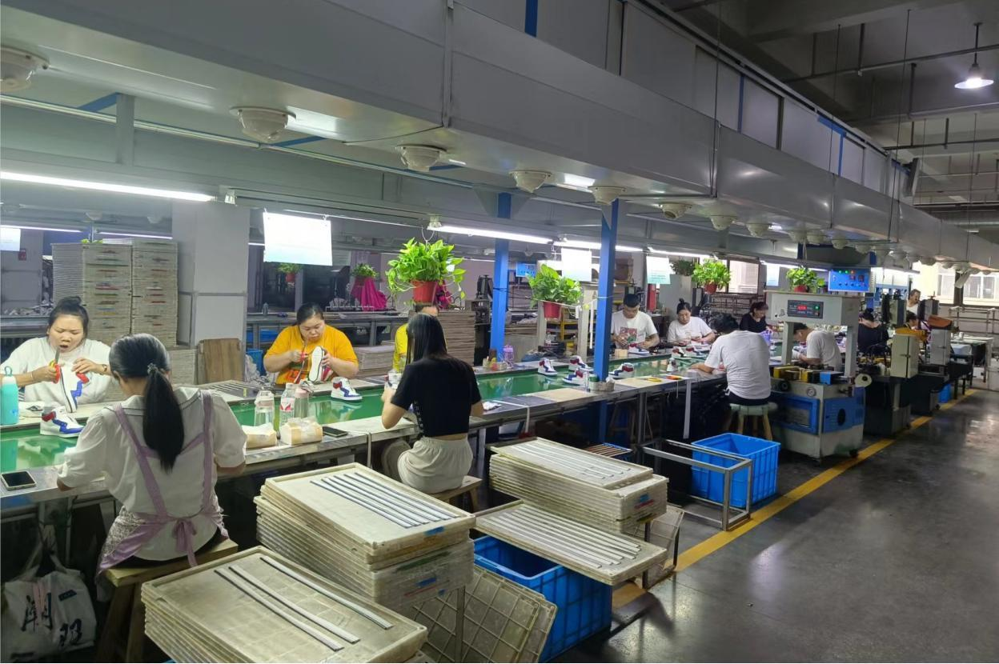
PART 7
PRODUCTION PROCESS OF SHOES
Lasting Department

Slide 10
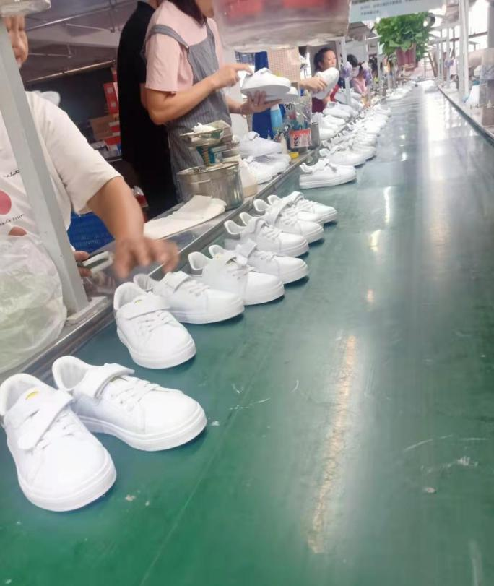
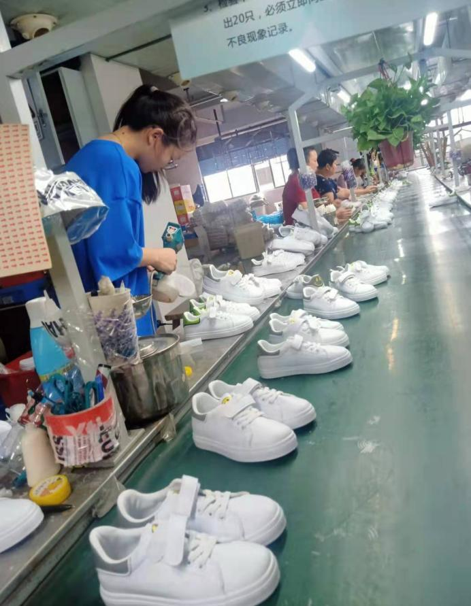
PART 8
PRODUCTION PROCESS OF SHOES
Packing Department
Thread Clean
Quality Inspection

Slide 11
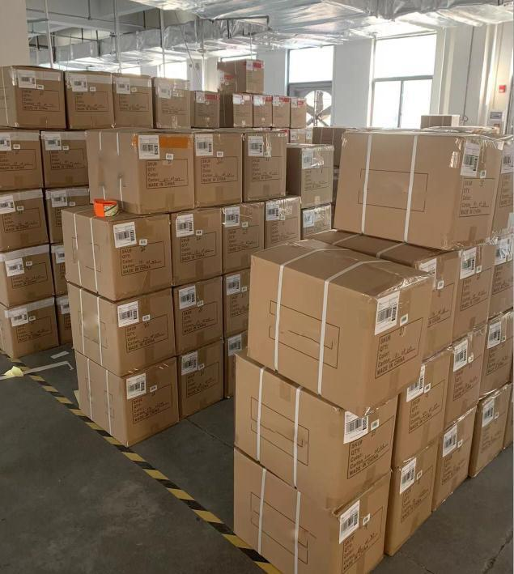
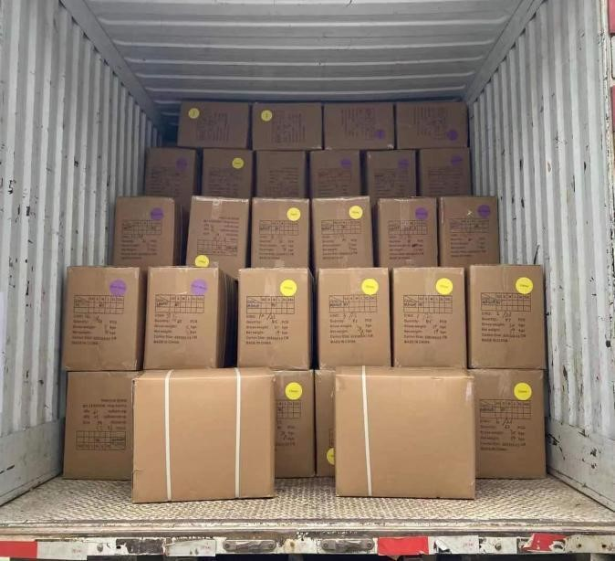
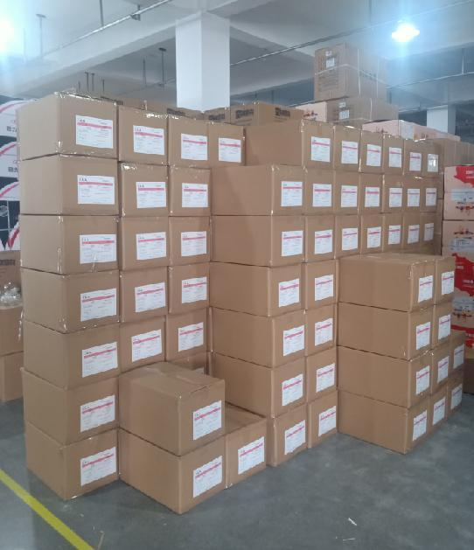
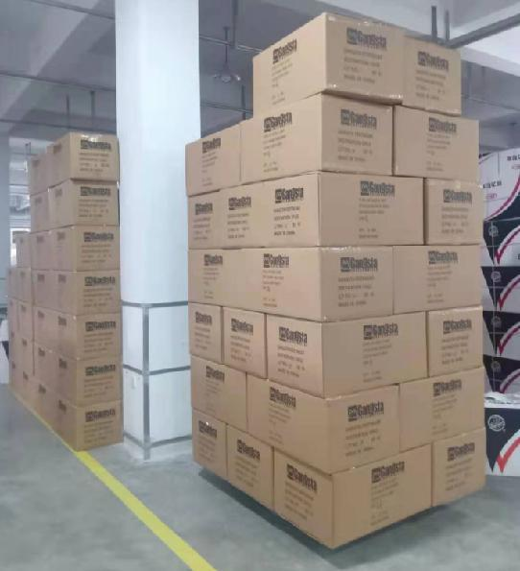
PRODUCTION PROCESS OF SHOES
PART 9
PRODUCT
Packing&Deliver

Slide 12
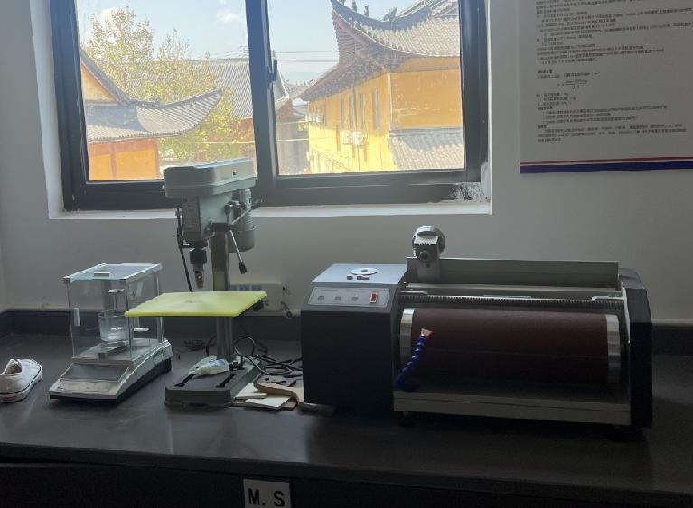
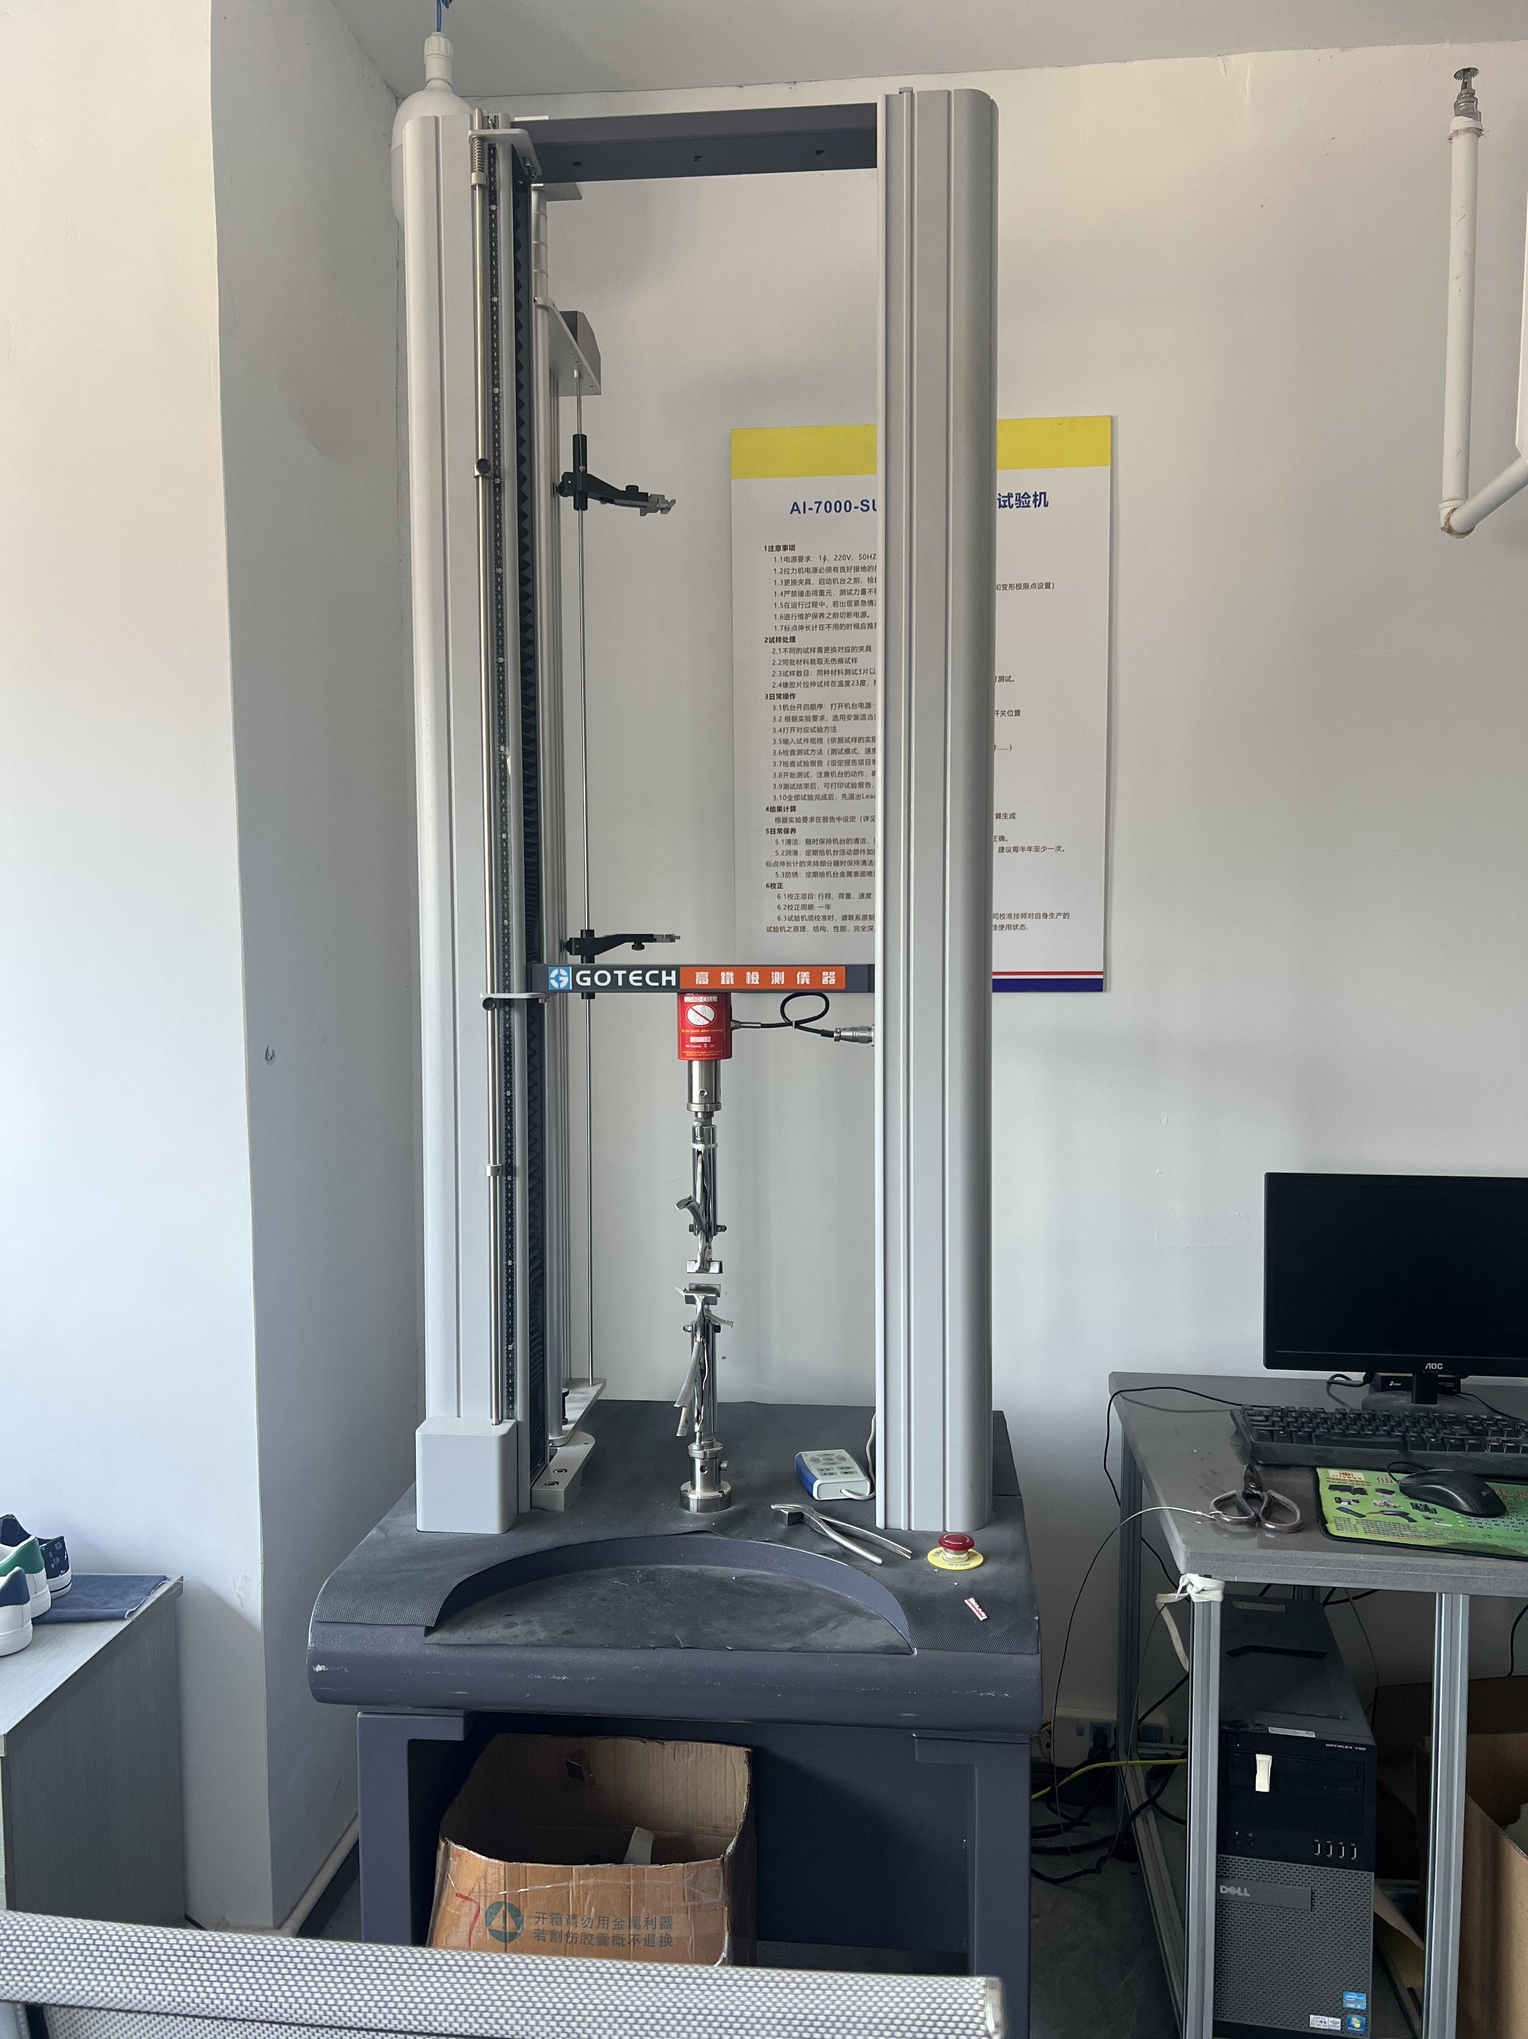
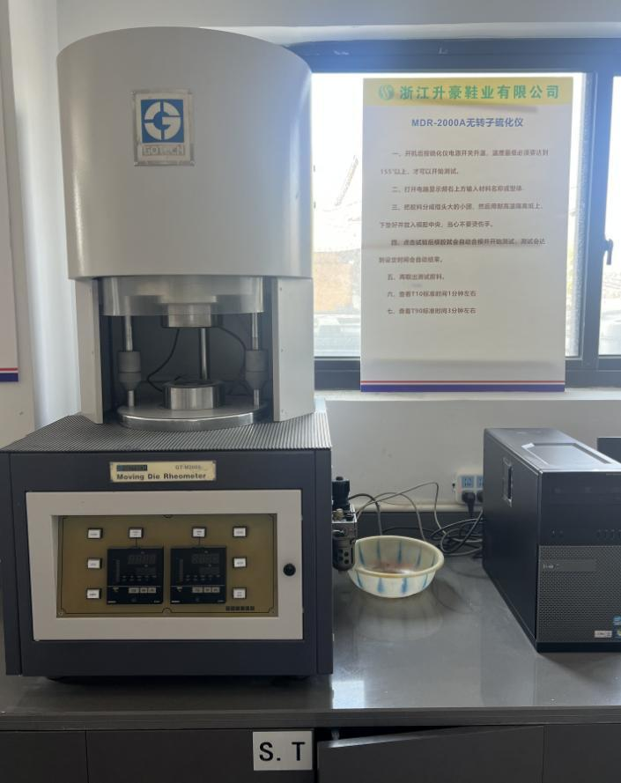
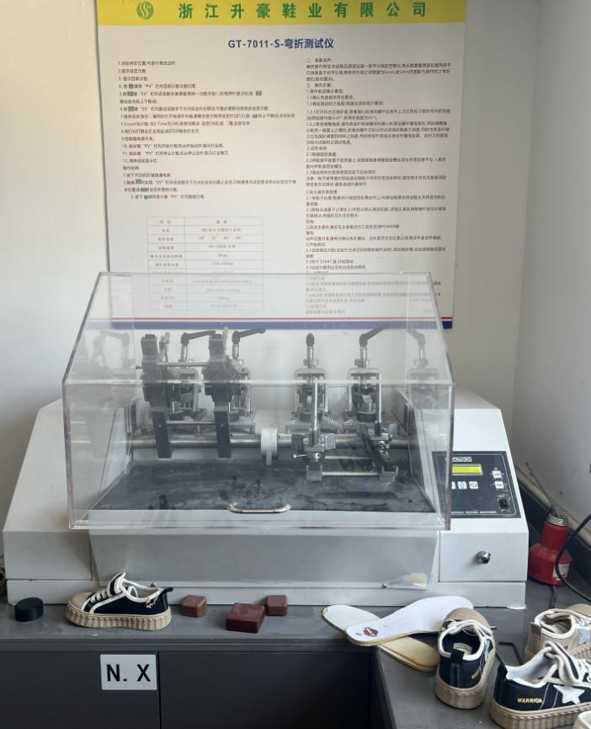
TESTING AREA
PART 10
PRODUCT
QUALITY CONTROL

Slide 13
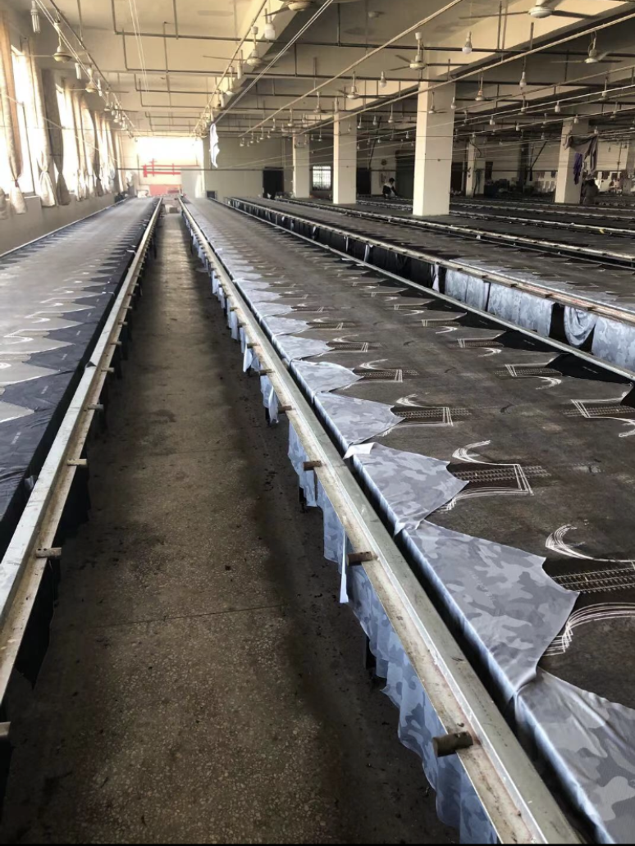
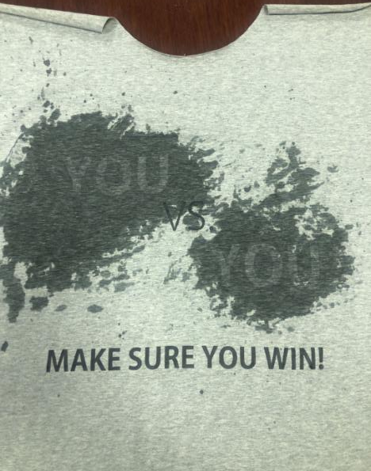
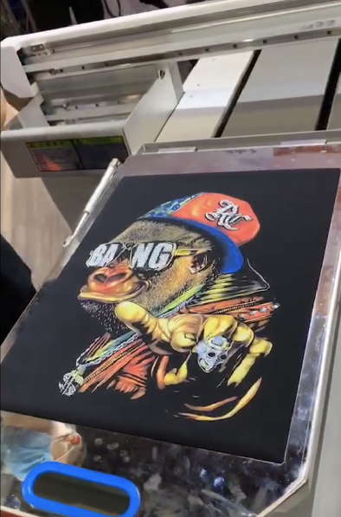
PART11
WHAT CAN WE DO??
PRODUCT
CAMO PRINTING
SWEAT ACTIVATED PRINTING
WHAT WE CAN DO?
--All Kinds Of Silk Screen Print
--Silicone Rubber Print&High Density Print
--High Quliaty Embroidery
DIGITAL PRINTING

Slide 14
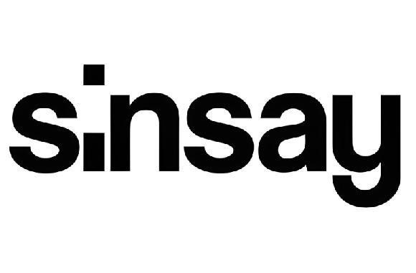
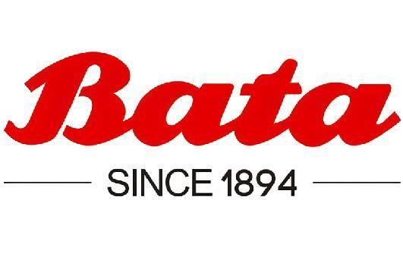

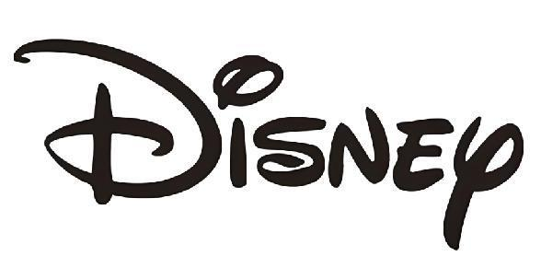
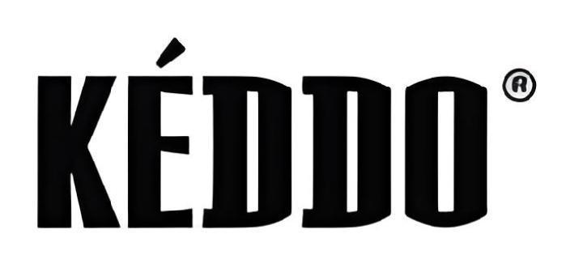
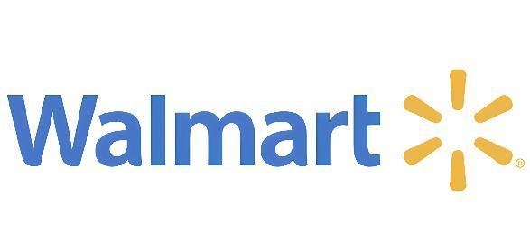
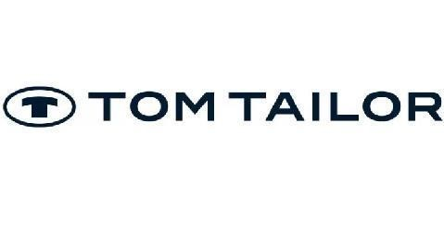


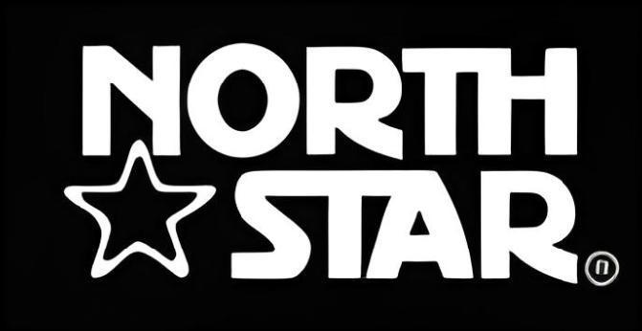
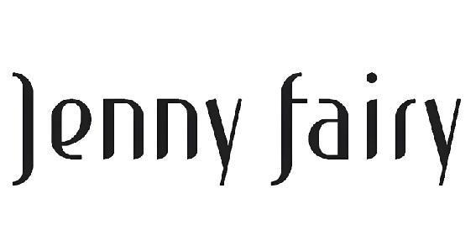
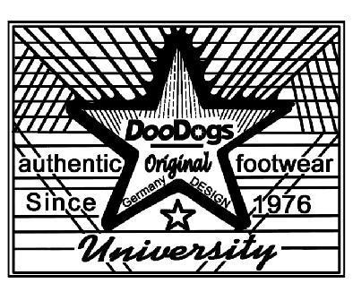
PART 12
PARTNERS

Slide 15
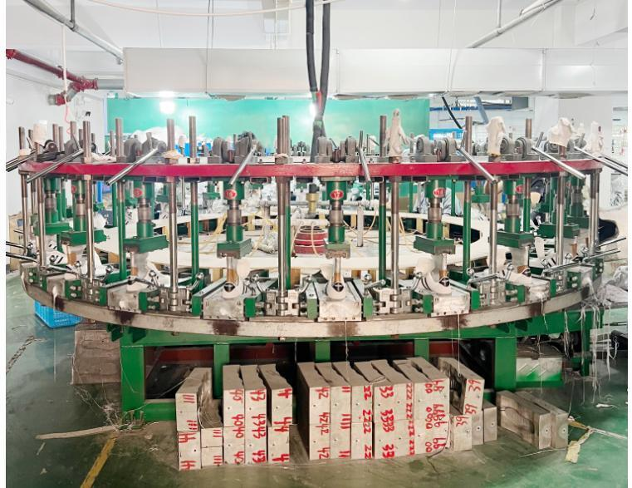
PART 13
PRODUCT RANGES
Our vulcanize factory have a 4000 square meter with 3 production lines. The daily output is 18000pairs. So we have lots of production space. There are 6 technicist and 20 workers in samle room to support customer’s developement. Normally the leadtime is one week for sample. For mass production, we always do self-testing for physical test &chemical test and also third-testing according to custormer’s requiement. Our factory have the certificates of BSCI and Disney Audit. Moreover, we have also set up perfect supplier chain. We can produce shoes with organic and recycle materials. And slso we have sales & after-sales service team.
「Vulcanized shoes」
「Injection shoes」
Injection Machine

Slide 16
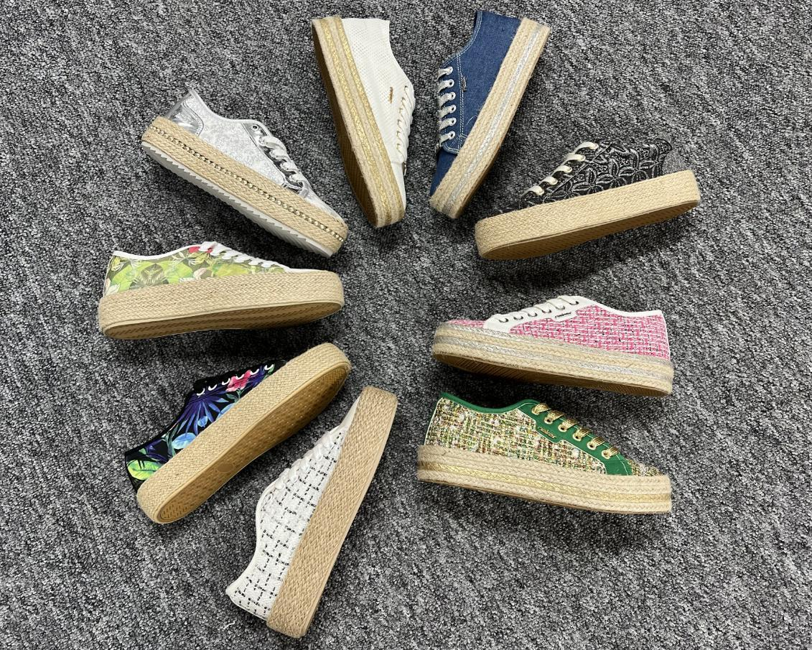
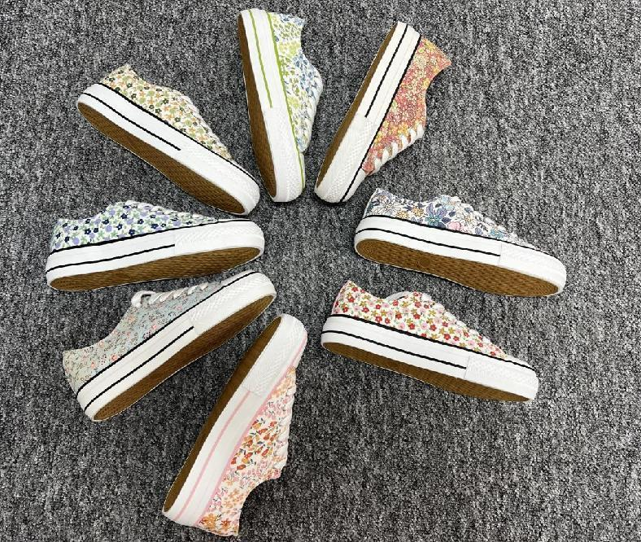
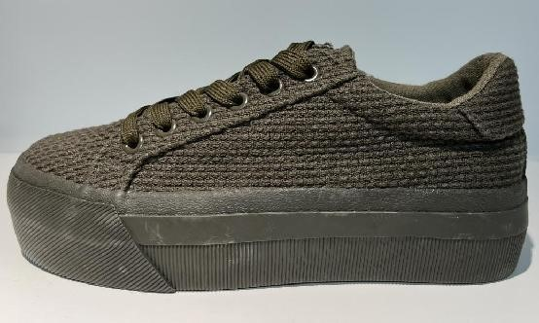
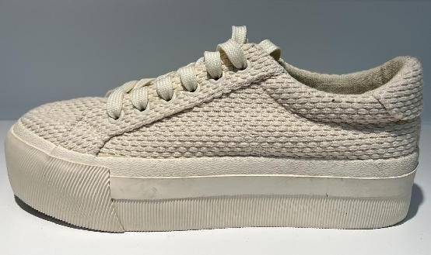
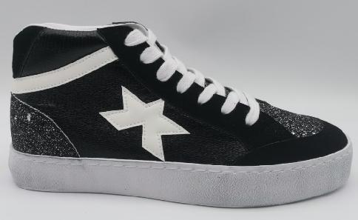
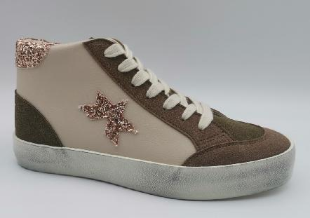
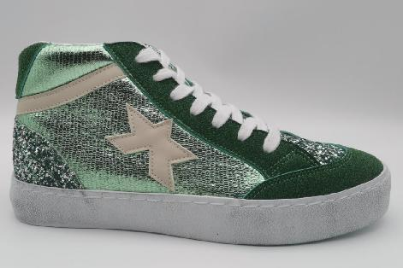
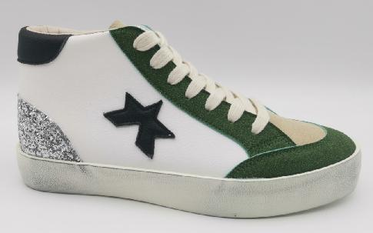
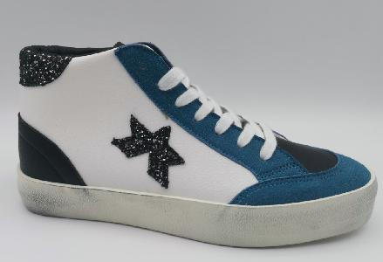
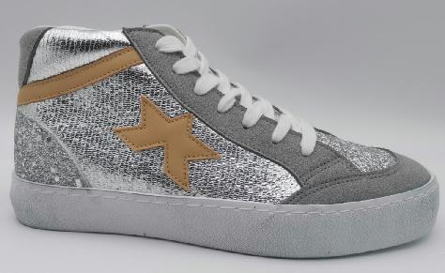
OUR PRODUCTS
PART 14
VULCANIZED

Slide 17
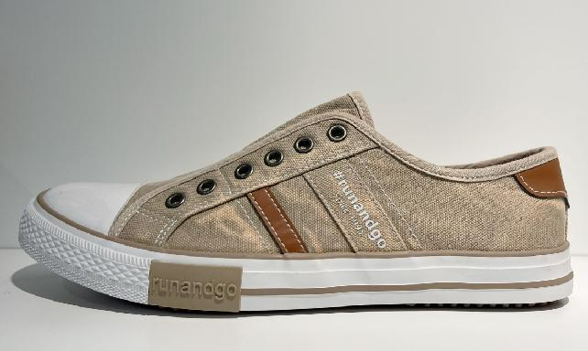











OUR PRODUCTS
PART 14
VULCANIZED

Slide 18












OUR PRODUCTS
OUR PRODUCTS
PART 14
CEMENTED

Slide 19












OUR PRODUCTS
PART 14
INJECTION

Slide 20









OUR PRODUCTS
PART 14
INJECTION

Slide 21




SHOW ROOM
PART 15

Slide 22

Get in touch with us
Send us a message or visit us
Whenever you like
Add:Rubber Shoes Industrial Park, Xianjiang Street, Ruian City, Zhejiang, China Email: peter@manyi-shoes.com Tel:+86 15888750003
THANK YOU!

